Slide 1

Wildlife Population
Intelligence System
Milestone 1
Presented by Harshitha S
B.E. Computer Science and Engineering
PSNA College of Engineering and Technology
AI-Powered
Wildlife
Species recognition
Conservation focused
Dashboard
Data
Centralized platform
Secure management

Slide 2
Problem
WPIS Solution
Why WPIS?
Centralized Data
The Challenge
Unified wildlife database
Wildlife data is collected manually and stored across scattered files.
Monitoring animal populations, field images, and observations becomes difficult to track.
Conservation teams lack a single secure system to manage wildlife information.
Smart Sites
Managed monitoring
locations
Secure Uploads
Encrypted field transfers
Our Objective
Build a centralized platform to manage monitoring sites, sensor devices, field uploads, and wildlife observations — enhanced by AI-based species recognition for faster identification.
AI Recognition
Automated species ID

Slide 3
Core System Modules Completed
Five interconnected modules form the foundation of the Wildlife Population Intelligence System.
01
02
03
User Authentication
Monitoring Sites
Sensor Devices
Secure login, registration, JWT authentication with role-based access for administrators and users.
Add and manage wildlife monitoring locations with geographic tracking.
Manage camera traps, acoustic sensors, GPS collars, and real-time device status.
04
05
Field Uploads
Observation Records
Upload wildlife images, audio, videos, and field documents securely.
Create wildlife observations linked to sites, devices, and uploads with admin verification workflow.

Slide 4
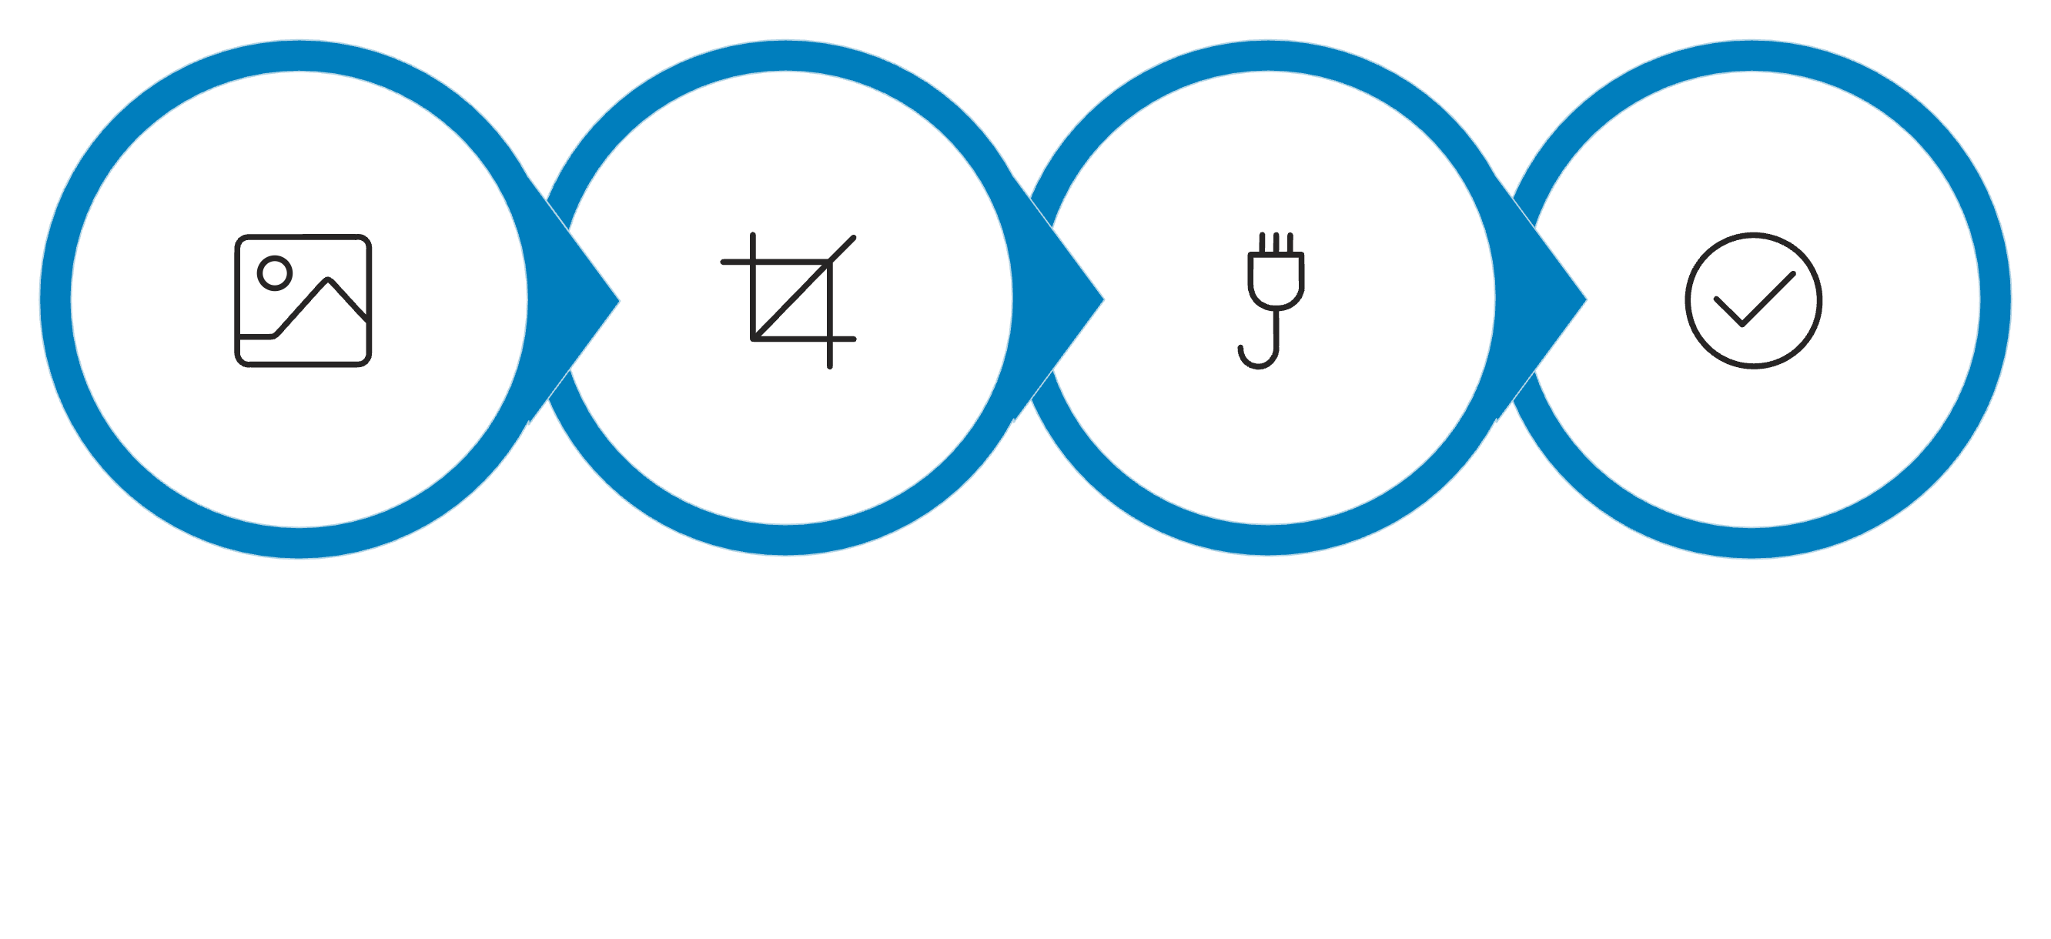
System Architecture and AI Species Classification
Technology Stack
AI/ML Work Completed
Frontend
Backend
Wildlife dataset prepared with 5,400 images across 11 animal categories.
Images validated and split into training, validation, and testing sets.
MobileNetV2 transfer-learning model created and trained.
Model saved as .keras file; class labels saved as JSON.
Secure FastAPI prediction API created for wildlife image classification.
React + Vite + Tailwind CSS
FastAPI REST API + JWT Auth
Database
AI / ML Layer
MongoDB Atlas (Cloud)
TensorFlow MobileNetV2 Model
Image Input
Preprocessing
MobileNetV2
Predicted Species

Slide 5
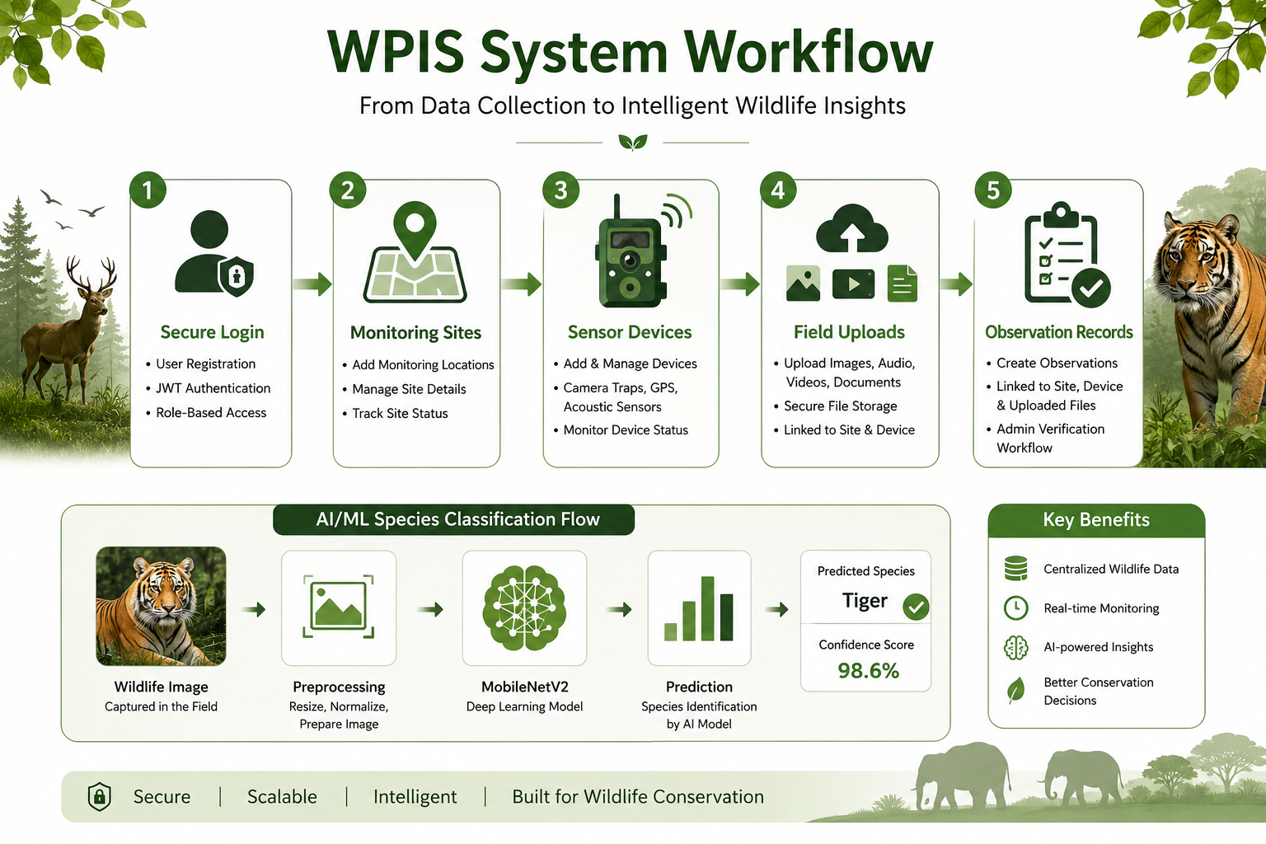

Slide 6
Milestone 1 Status and Next Steps
Current Status
Next Steps
Authentication, Monitoring Sites, Sensor Devices, Field Uploads, and Observation Records — completed.
Frontend, backend, and MongoDB Atlas are fully connected.
Wildlife image upload and observation creation are working.
ML model trained and connected to backend prediction API.
Test the AI prediction API using real wildlife images.
Display predicted species and confidence score in the frontend.
Store AI prediction results in MongoDB.
Auto-create observations from AI predictions.
Improve model accuracy and prepare for deployment.
Thank You

